Slide 1

DIYALA UNIVERSITY
COLLEGE OF ENGINEERING
DEPARTMENT OF COMMUNICATIONS ENGINEERING
Electronic Circuits I
Second Year- Lecture 7
Asst. lecturer
Wisam Hayder
2020 _ 2021

Slide 2
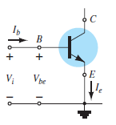
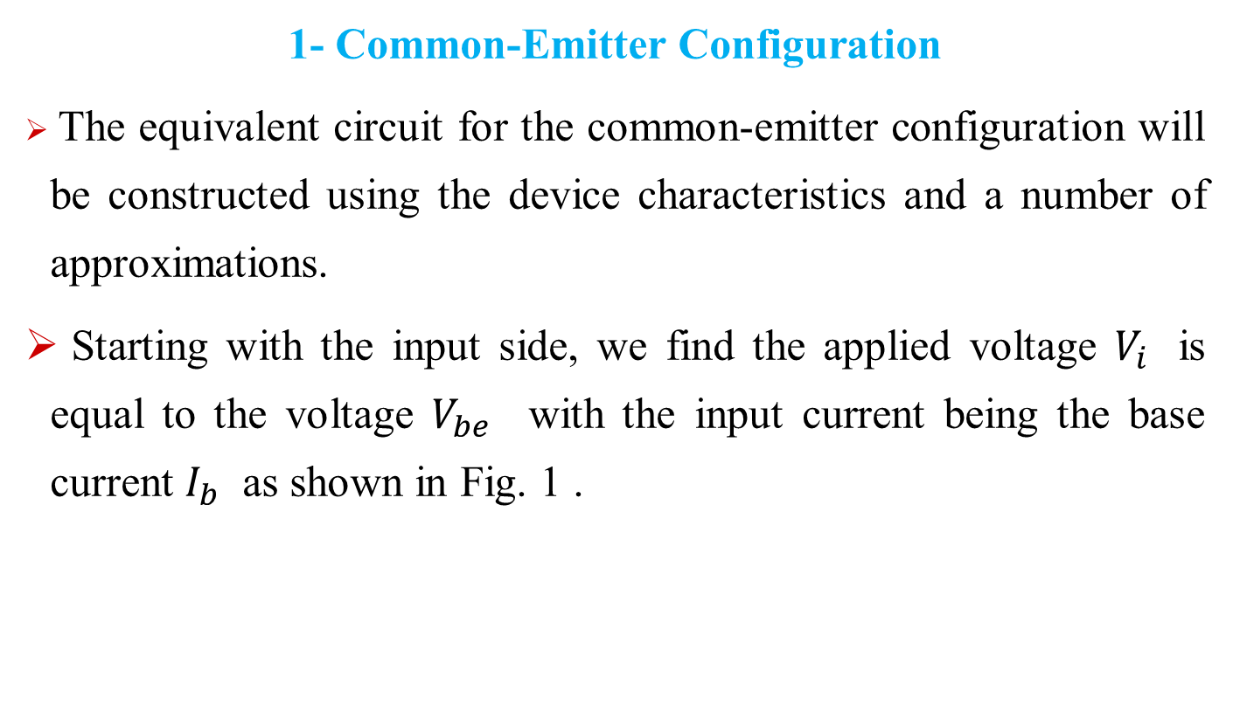
The re transistor model
1- Common-Emitter Configuration
The equivalent circuit for the common-emitter configuration will be constructed using the device characteristics and a number of approximations.
Starting with the input side, we find the applied voltage $V_{i}$ is equal to the voltage $V_{be}$ with the input current being the base current $I_{b}$ as shown in Fig. 1 .
Fig.1. Finding the input equivalent circuit for a BJT transistor
Notes:
aaa

Slide 3
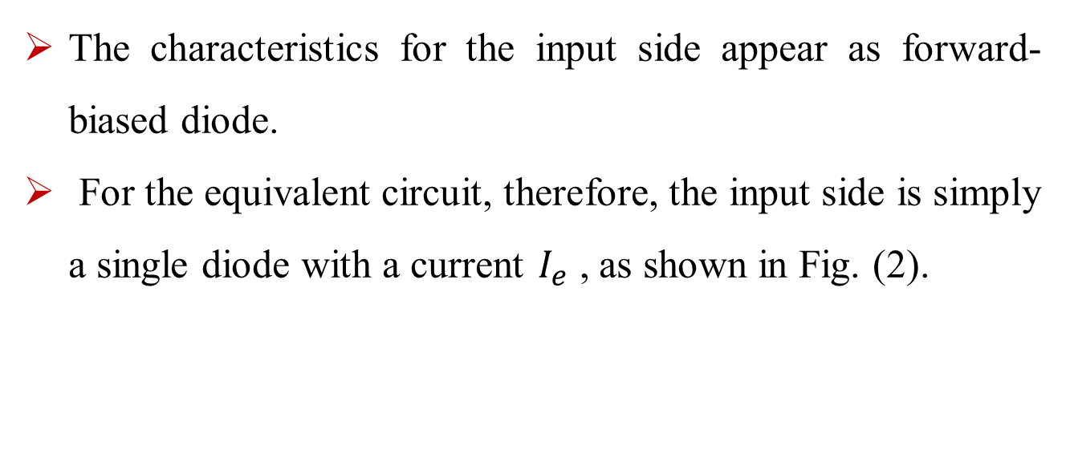
The re transistor model
The characteristics for the input side appear as forward-biased diode.
For the equivalent circuit, therefore, the input side is simply a single diode with a current $I_{e}$ , as shown in Fig. (2).
Fig.2. Equivalent circuit for the input side of a BJT transistor
Notes:
aaa

Slide 4
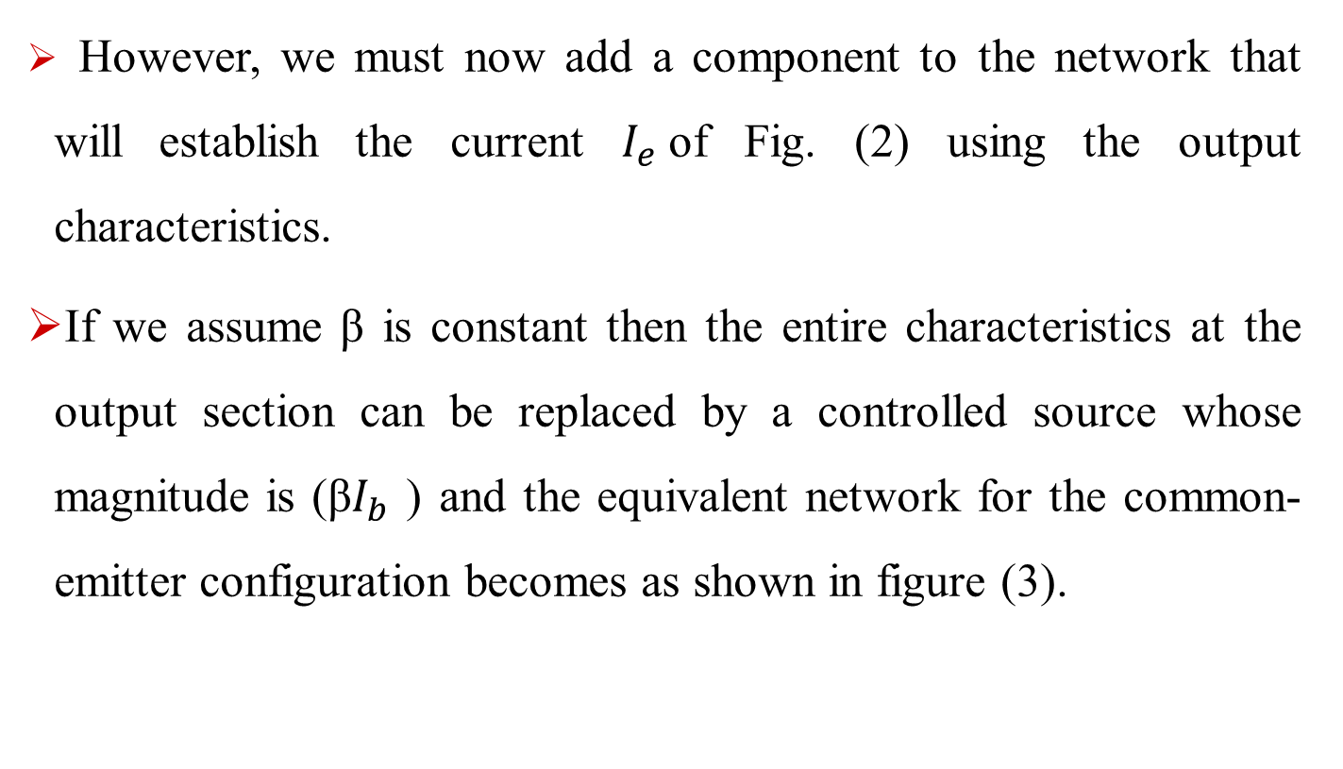
The re transistor model
However, we must now add a component to the network that will establish the current $I_{e}$of Fig. (2) using the output characteristics.
If we assume β is constant then the entire characteristics at the output section can be replaced by a controlled source whose magnitude is (β$I_{b}$ ) and the equivalent network for the common-emitter configuration becomes as shown in figure (3).
Notes:
aaa

Slide 5
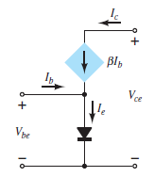
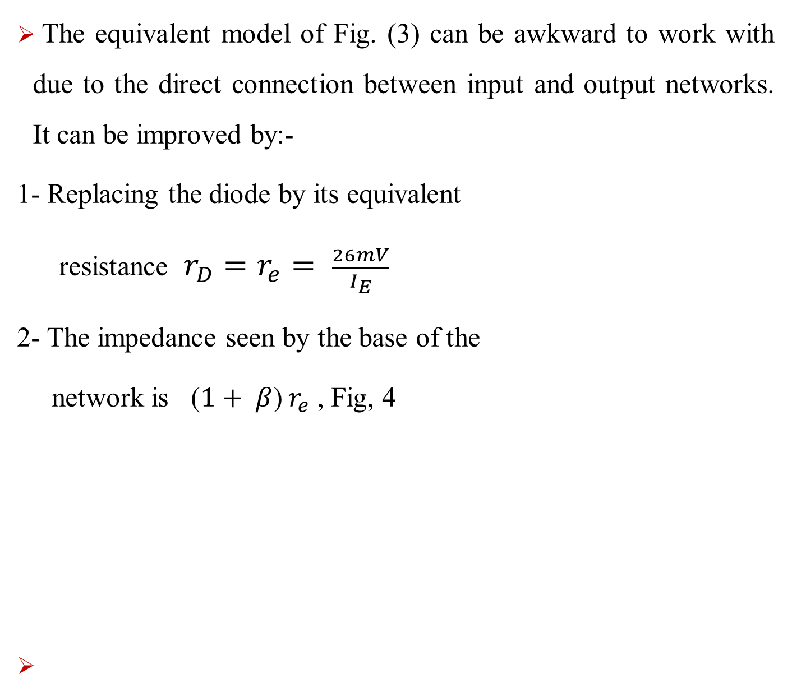
The re transistor model
The equivalent model of Fig. (3) can be awkward to work with due to the direct connection between input and output networks. It can be improved by:-
1- Replacing the diode by its equivalent
resistance $r_{D}=r_{e}= \frac{26mV}{I_{E}}$
2- The impedance seen by the base of the
network is ($1+ β$) $r_{e}$ , Fig, 4
Fig.3 BJT equivalent circuit.
Notes:
aaa

Slide 6
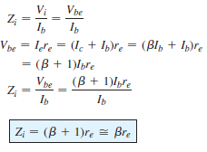
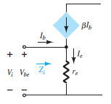

The re transistor model
Fig.4 Defining the level of $r_{e}$ .
Notes:
aaa

Slide 7
The re transistor model
The collector output current is still linked to the input current by 𝛽 as Shown
Fig.5 Improved BJT equivalent circuit.
Notes:
aaa

Slide 8
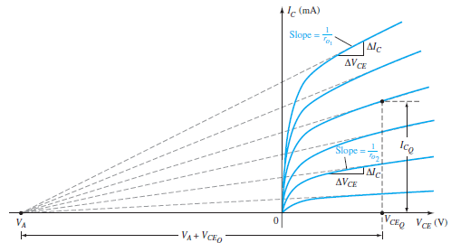

The re transistor model
We now have a good representation for the input circuit, but aside from the collector output current being defined by the level of beta and $I_{B}$, we do not have a good representation for the output impedance of the device.
Fig.6. Defining the Early voltage and the output impedance of a transistor
Notes:
aaa

Slide 9

The re transistor model
Notes:
aaa

Slide 10
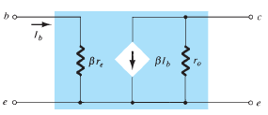
The re transistor model
In any event, an output impedance can now be defined that will appear as a resistor in parallel with the output as shown in the equivalent circuit of Fig. (7) .
Fig.7. $r_{e}$ model for the common-emitter transistor configuration including effects of $r_{0}$ .
Notes:
aaa

Slide 11
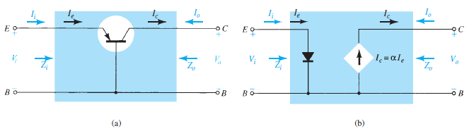
The re transistor model
2- Common-Base Configuration
For the common-base configuration of Fig. 8. a the pnp transistor employed will present the same possibility at the input circuit.
The result is the use of a diode in the equivalent circuit as shown in Fig. 8. b
Fig. 8. (a) Common-base BJT transistor; (b) equivalent circuit for configuration of (a).
Notes:
aaa

Slide 12

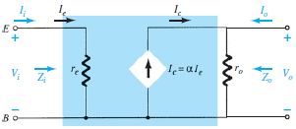

The re transistor model
The direction of the collector current in the output circuit is now opposite that of the defined output current.
the diode can be replaced by its equivalent ac resistance determined by $r_{e}= \frac{26mV}{I_{E}}$ as shown in Fig. 9 .
From Fig. (9), Common base${ r}_{e}$ equivalent circuit.
Notes:
aaa

Slide 13
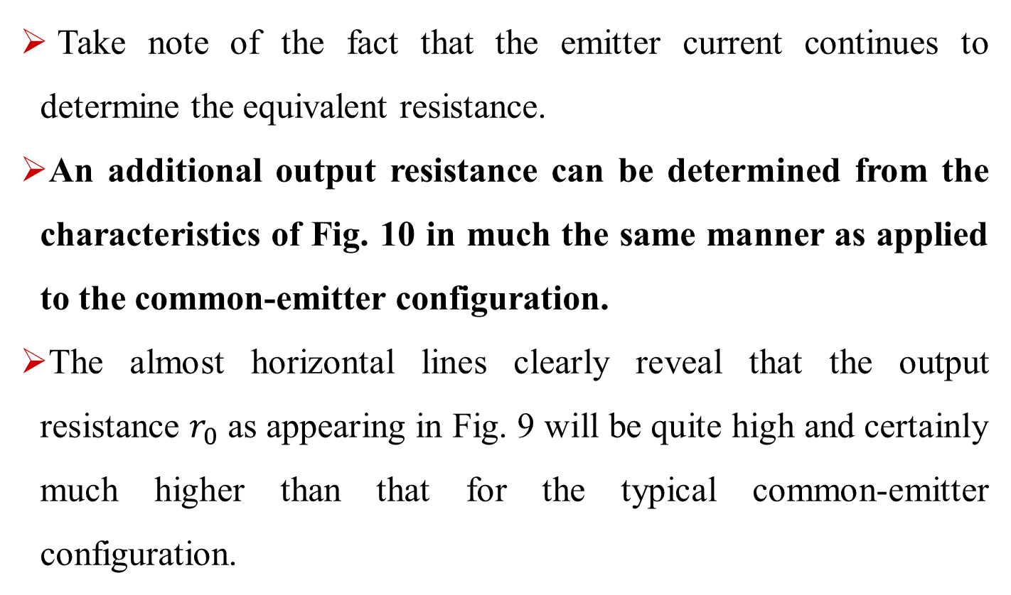
The re transistor model
Take note of the fact that the emitter current continues to determine the equivalent resistance.
An additional output resistance can be determined from the characteristics of Fig. 10 in much the same manner as applied to the common-emitter configuration.
The almost horizontal lines clearly reveal that the output resistance $r_{0}$ as appearing in Fig. 9 will be quite high and certainly much higher than that for the typical common-emitter configuration.
Notes:
aaa

Slide 14
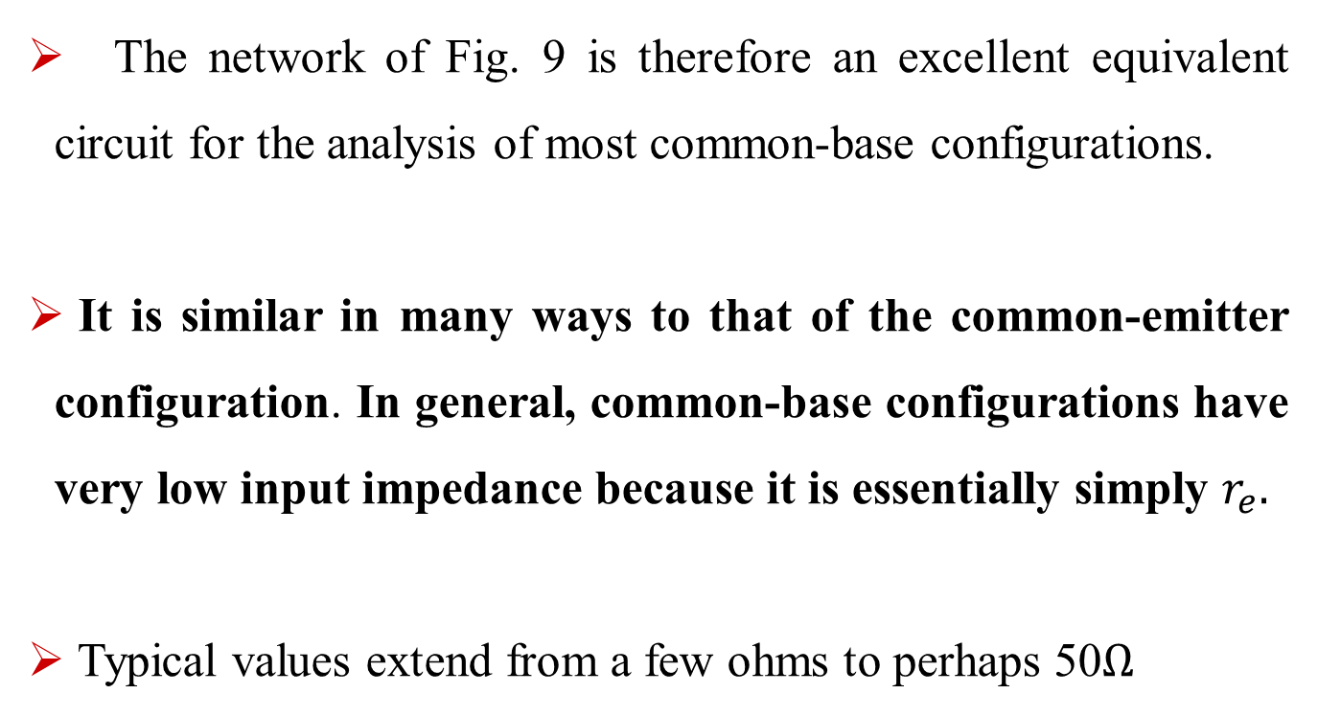
The re transistor model
The network of Fig. 9 is therefore an excellent equivalent circuit for the analysis of most common-base configurations.
It is similar in many ways to that of the common-emitter configuration. In general, common-base configurations have very low input impedance because it is essentially simply $r_{e}.$
Typical values extend from a few ohms to perhaps 50$Ω$
Notes:
aaa

Slide 15
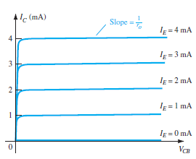
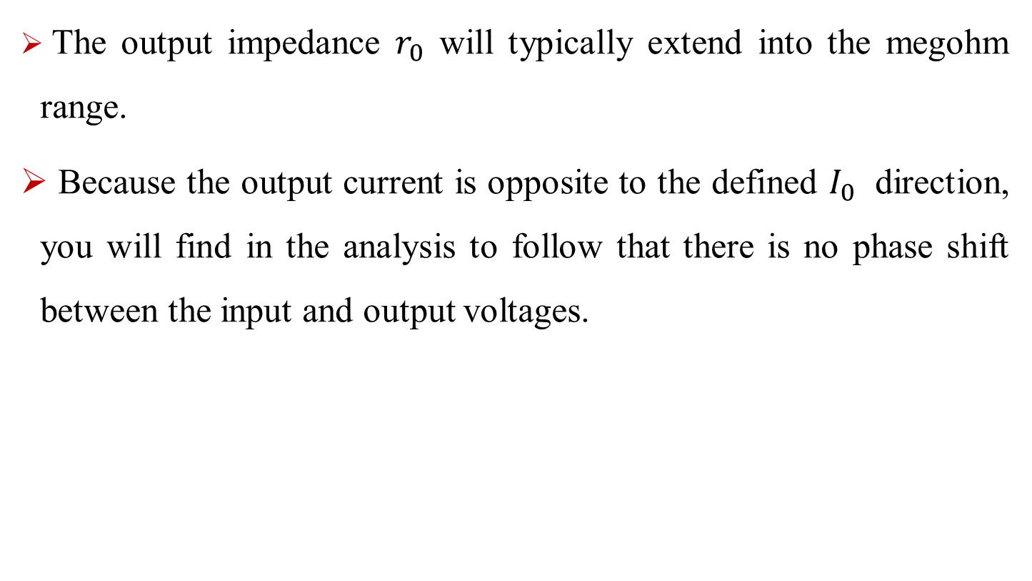

The re transistor model
The output impedance $r_{0}$ will typically extend into the megohm range.
Because the output current is opposite to the defined $I_{0}$ direction, you will find in the analysis to follow that there is no phase shift between the input and output voltages.
Fig. 10. Defining $Z_{0}$ .
Notes:
aaa

Slide 16
The re transistor model
3- Common-Collector Configuration
For the common-collector configuration, the model defined for the common-emitter configuration of Fig. 7. is normally applied rather than defining a model for the common-collector configuration.
In subsequent lectures, a number of common-collector configurations will be investigated, and the effect of using the same model will become quite apparent.
Notes:
aaa

Slide 17
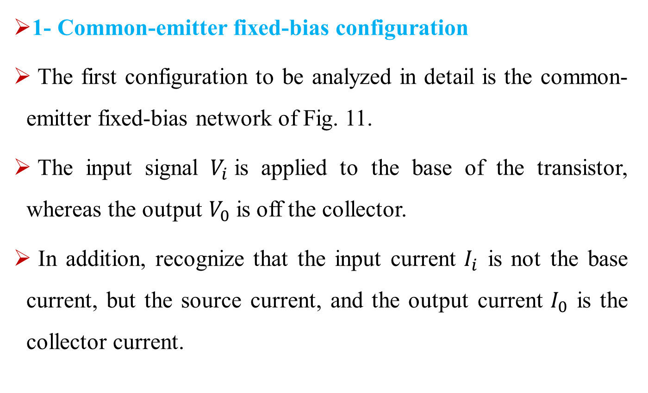
BJT Small-signal ac analysis
1- Common-emitter fixed-bias configuration
The first configuration to be analyzed in detail is the common-emitter fixed-bias network of Fig. 11.
The input signal $V_{i}$is applied to the base of the transistor, whereas the output $V_{0}$is off the collector.
In addition, recognize that the input current $I_{i}$ is not the base current, but the source current, and the output current $I_{0}$ is the collector current.
Notes:
aaa

Slide 18
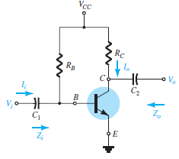
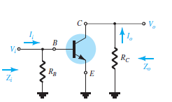
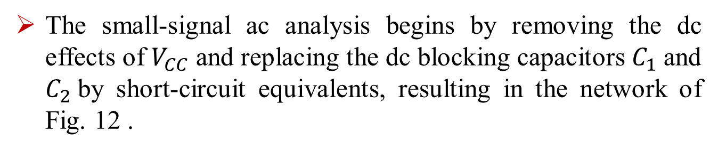

BJT Small-signal ac analysis
The small-signal ac analysis begins by removing the dc effects of $V_{CC}$and replacing the dc blocking capacitors $C_{1}$and $C_{2}$by short-circuit equivalents, resulting in the network of Fig. 12 .
Fig 11. Common-emitter fixed-bias configuration.
Network of Fig. 12. following the removal of the effects of $V_{CC}$, $C_{1}$ , and $C_{2}$ .
Notes:
aaa

Slide 19
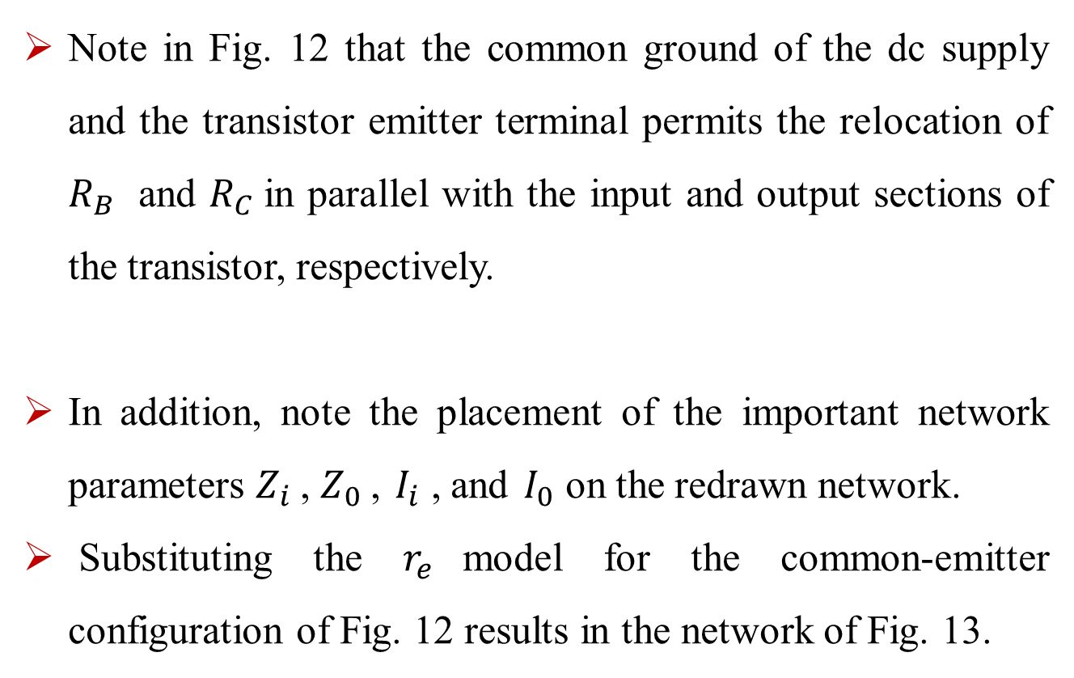
BJT Small-signal ac analysis
Note in Fig. 12 that the common ground of the dc supply and the transistor emitter terminal permits the relocation of $R_{B}$ and $R_{C}$in parallel with the input and output sections of the transistor, respectively.
In addition, note the placement of the important network parameters $Z_{i}$, $Z_{0}$, $I_{i}$ , and $I_{0}$ on the redrawn network.
Substituting the $r_{e}$model for the common-emitter configuration of Fig. 12 results in the network of Fig. 13.

Slide 20
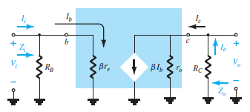
BJT Small-signal ac analysis
Fig. 13. Substituting the $r_{e}$ model into the network of Fig. 12.

Slide 21
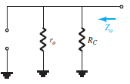

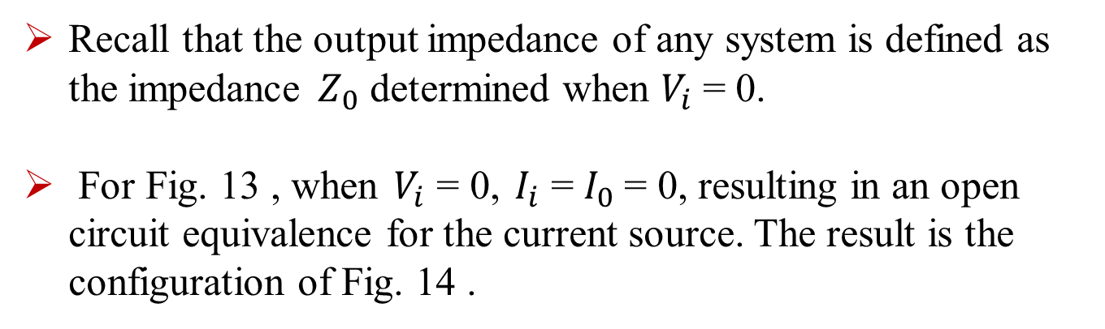
BJT Small-signal ac analysis
Recall that the output impedance of any system is defined as the impedance $Z_{0}$ determined when $V_{i}$= 0.
For Fig. 13 , when $V_{i}$ = 0, $I_{i}$ = $I_{0}$= 0, resulting in an open circuit equivalence for the current source. The result is the configuration of Fig. 14 .

Slide 22
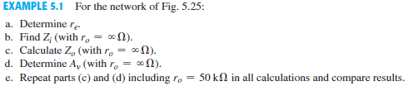
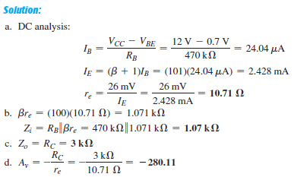
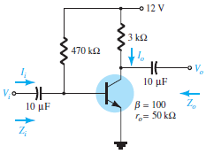

BJT Small-signal ac analysis

Slide 23
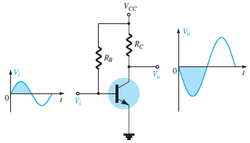
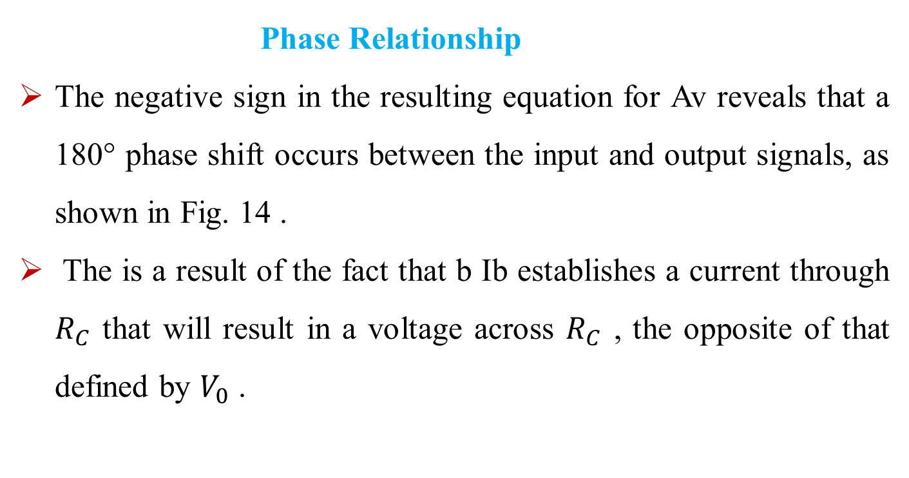
BJT Small-signal ac analysis
Phase Relationship
The negative sign in the resulting equation for Av reveals that a 180° phase shift occurs between the input and output signals, as shown in Fig. 14 .
The is a result of the fact that b Ib establishes a current through $R_{C}$ that will result in a voltage across $R_{C}$ , the opposite of that defined by $V_{0}$ .
Fig. 14. Demonstrating the 180° phase shift
between input and output waveforms

Slide 24
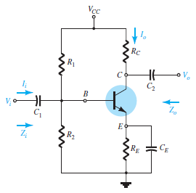
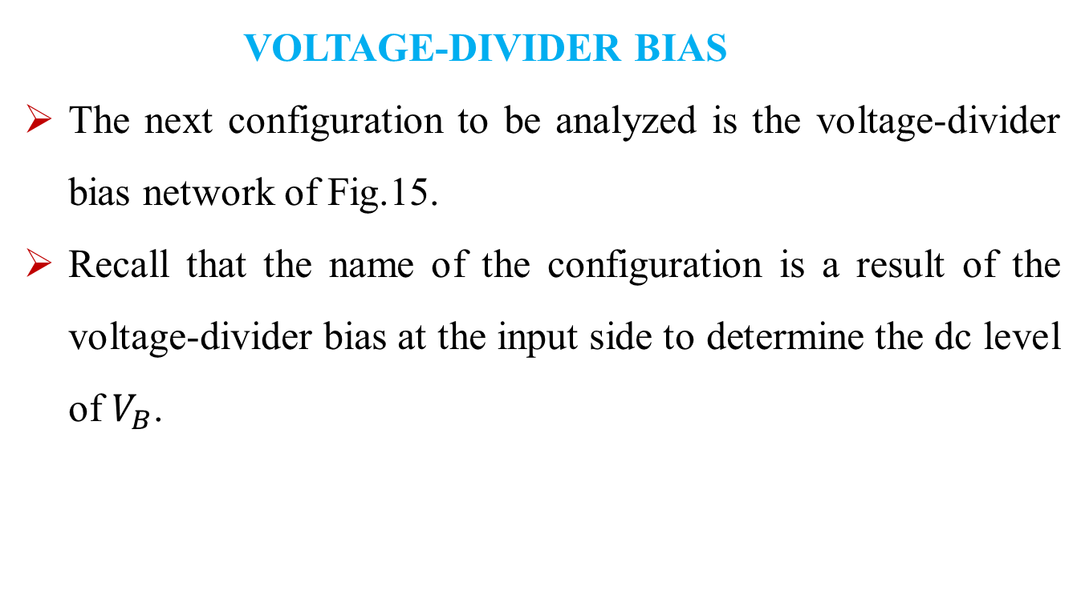
BJT TRANSISTOR MODELING
VOLTAGE-DIVIDER BIAS
The next configuration to be analyzed is the voltage-divider bias network of Fig.15.
Recall that the name of the configuration is a result of the voltage-divider bias at the input side to determine the dc level of $V_{B}$.
Fig. 15. Voltage-divider bias configuration

Slide 25
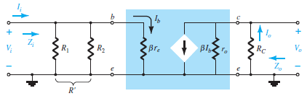
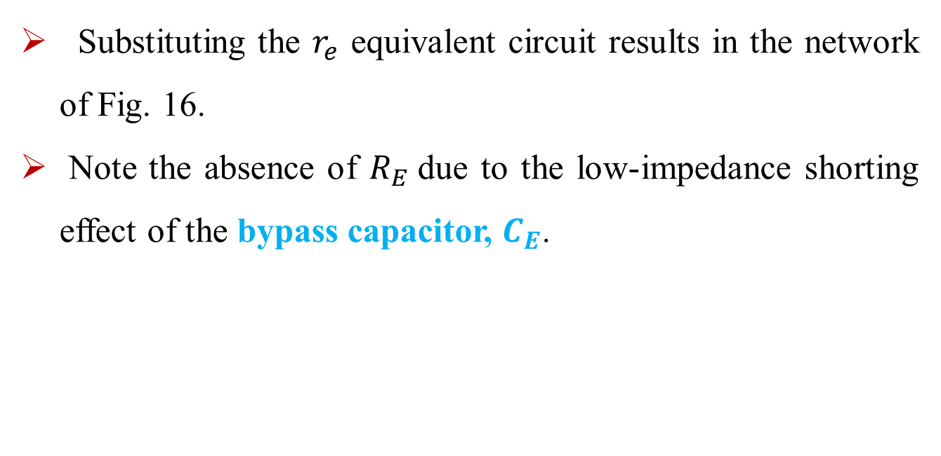
BJT Small-signal ac analysis
Substituting the $r_{e}$ equivalent circuit results in the network of Fig. 16.
Note the absence of $R_{E}$due to the low-impedance shorting effect of the bypass capacitor, $C_{E}$.
Fig. 16. Substituting the r e equivalent circuit into the ac equivalent network of Fig. 15 .

Slide 26
BJT Small-signal ac analysis
Phase Relationship. The negative sign of Eq. reveals a 180° phase shift between Vo and Vi .

Slide 27
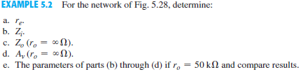
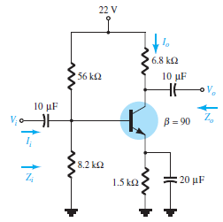
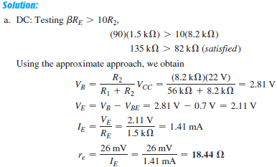
BJT Small-signal ac analysis

Slide 28
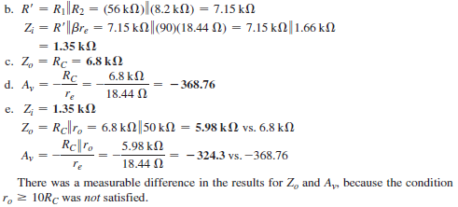
BJT Small-signal ac analysis

